Slide 1

Steganography

Slide 2
What’s the difference between hiding a message and encrypting it?

Slide 3
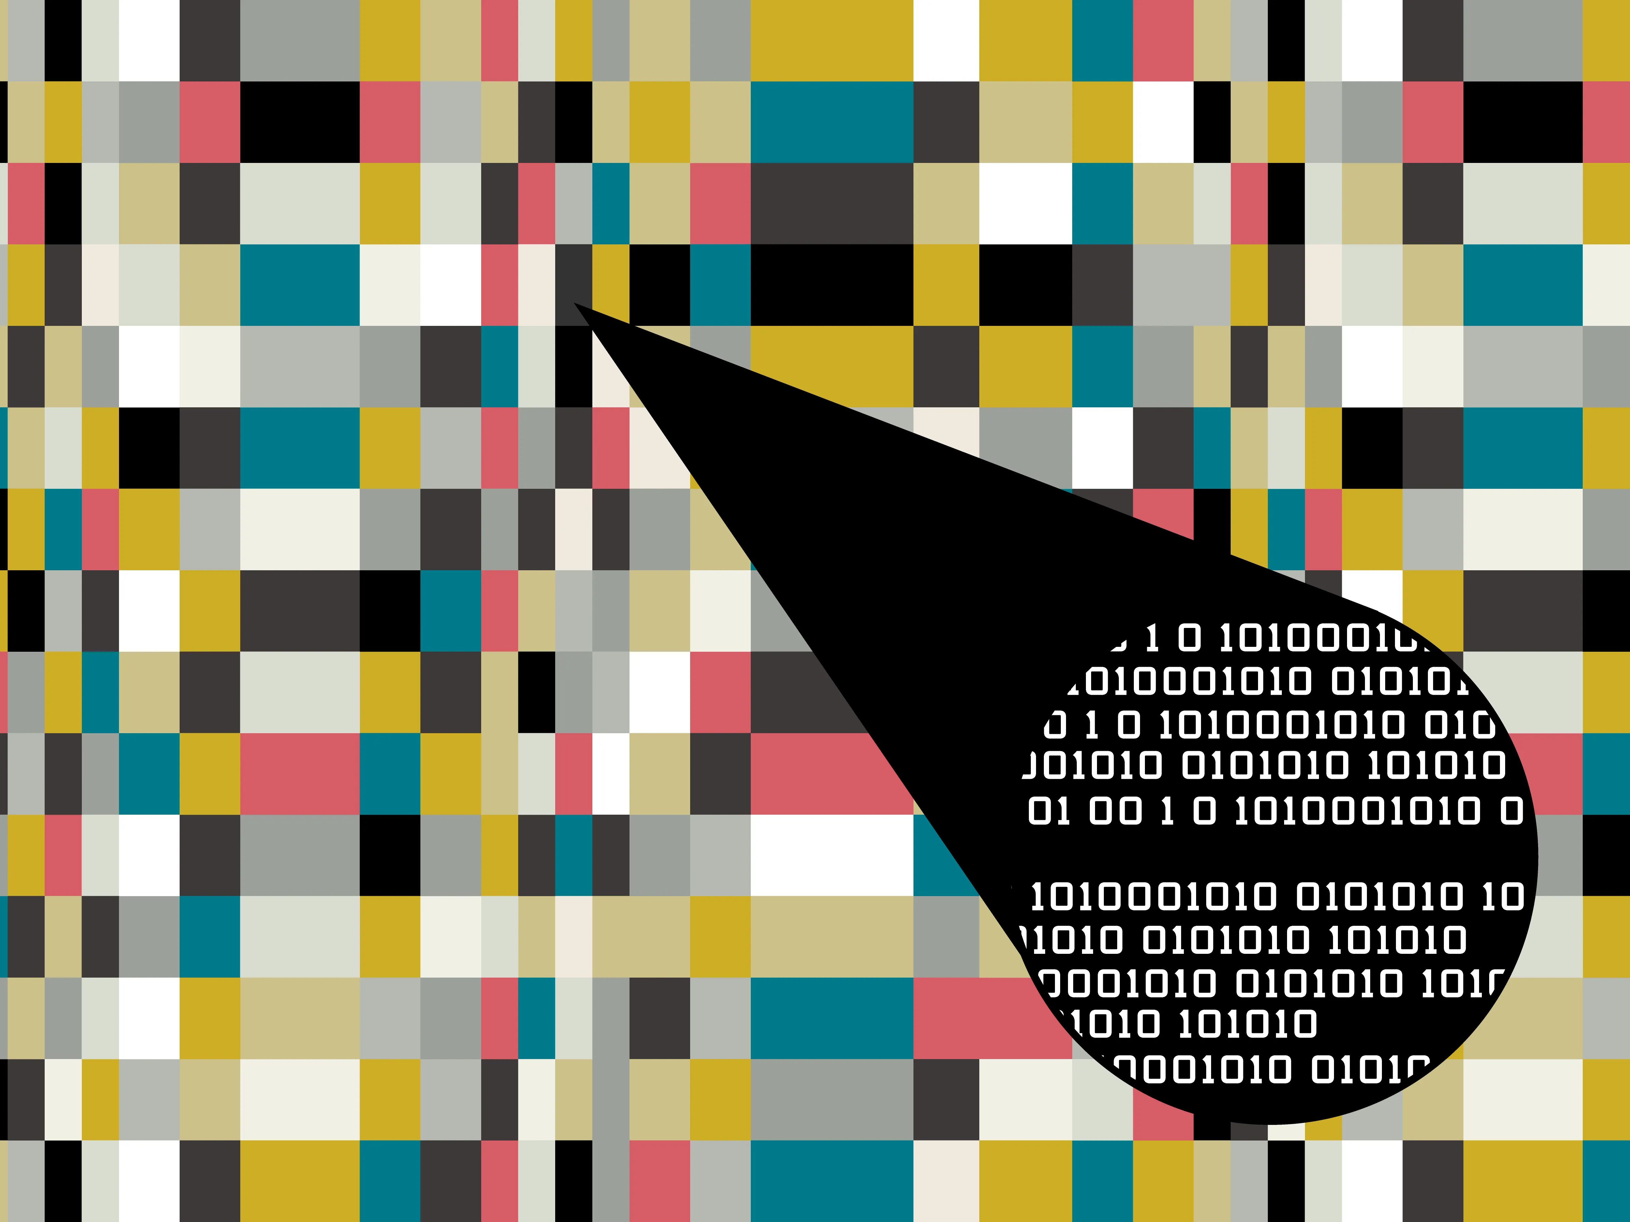
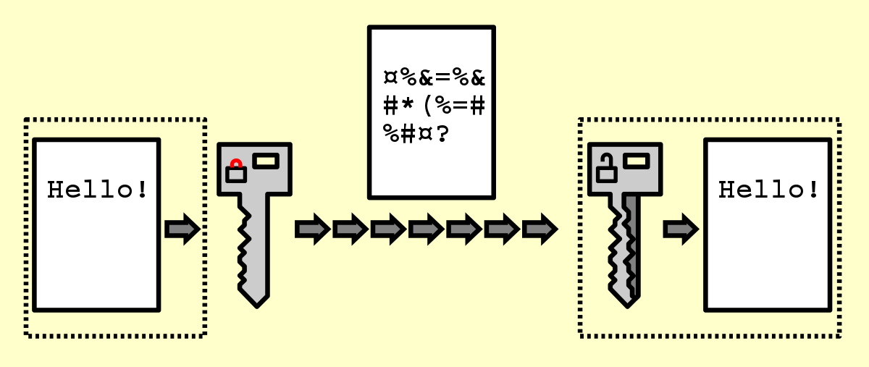
Steganography
VS
Encryption

Slide 4
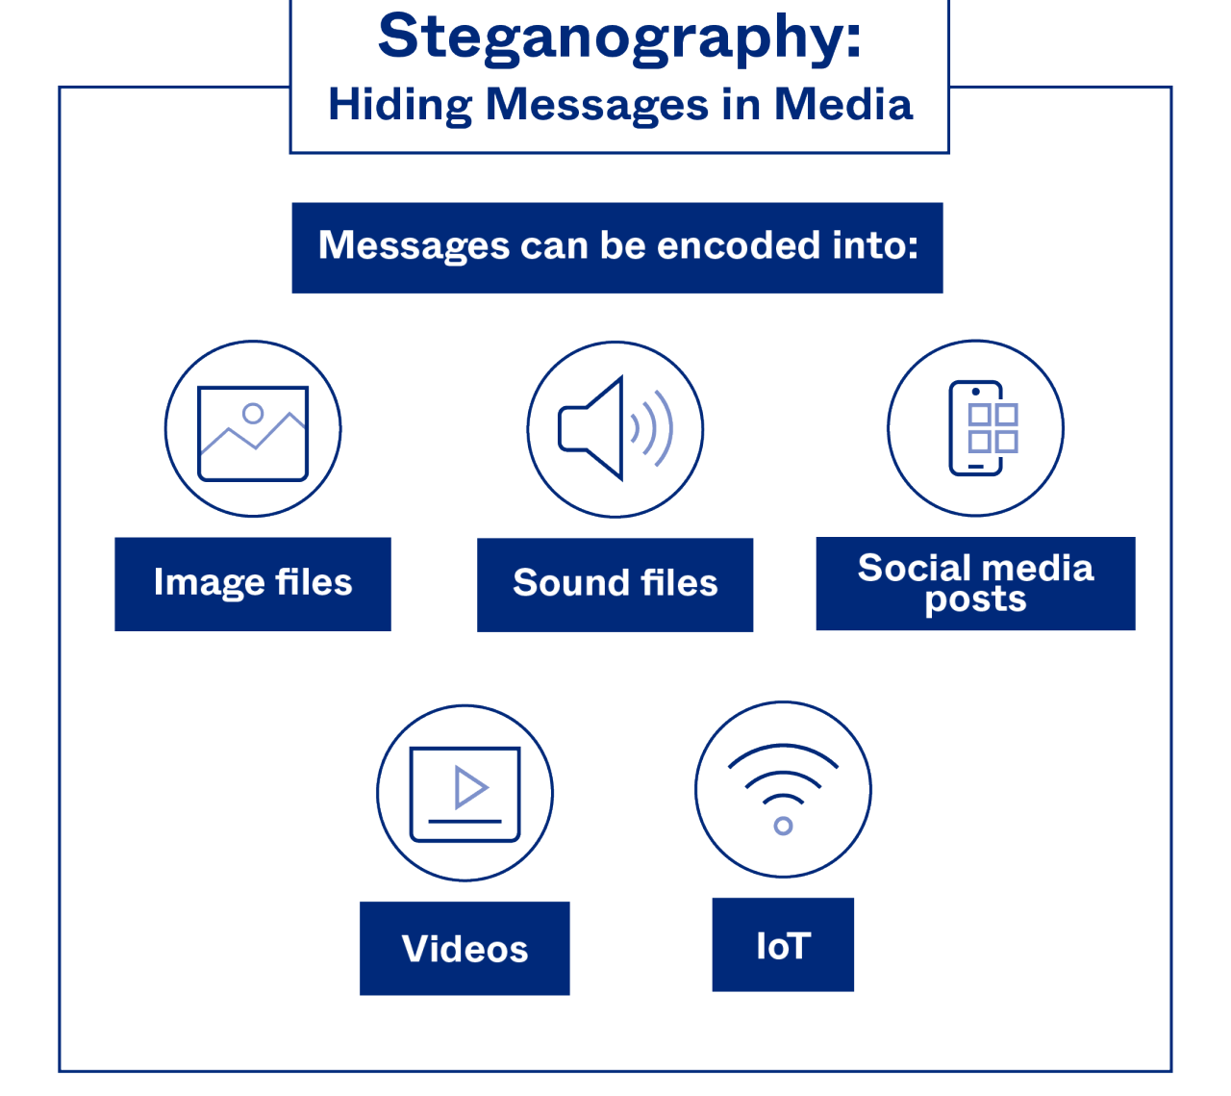
What is steganography?
Steganography = hiding a message inside another ordinary medium (image, audio, video, text)
Goal: hide the existence of the message.
Often combined with cryptography (crypto scrambles; stego hides)

Slide 5
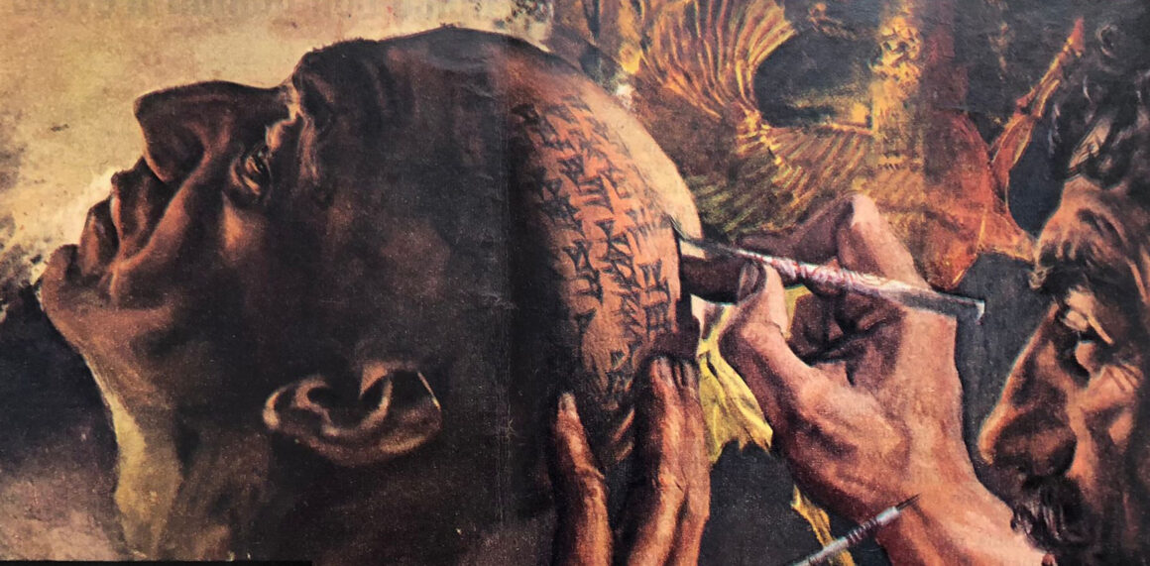
Origins
First known example: Herodotus, Histories (Book V).
Story: A slave’s head was shaved, scalp tattooed with a secret message, hair regrown, then sent to deliver it.

Slide 6
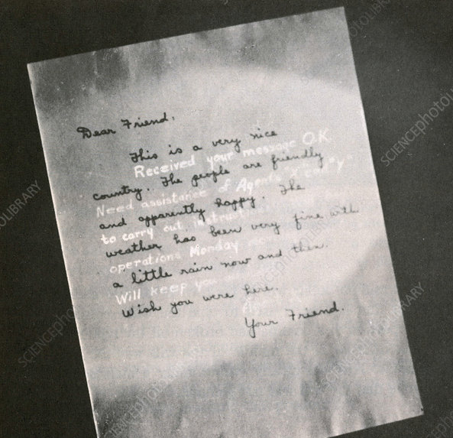
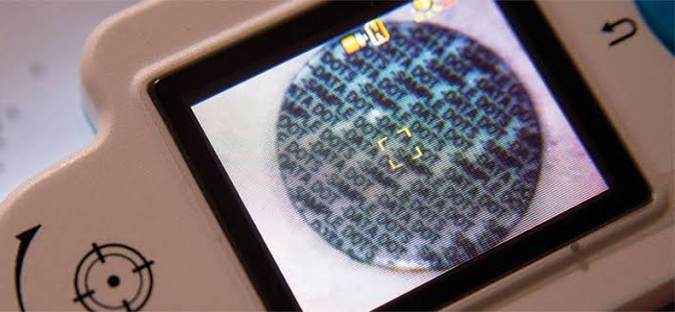
Pre-digital methods
Invisible ink
Microdots (tiny photos with reduced documents)

Slide 7
Textual steganography
E.A. Poe "An Arcostic"
Elizabeth it is in vain you say
"Love not" — thou sayest it in so sweet a way:
In vain those words from thee or L.E.L.
Zantippe's talents had enforced so well:
Ah! if that language from thy heart arise,
Breath it less gently forth — and veil thine eyes.
Endymion, recollect, when Luna tried
To cure his love — was cured of all beside —
His folly — pride — and passion — for he died
Notes:
Note for andy: dutch national anthem also has a hidden arcostic: first letter of each verse spells WILLEM VAN NASSOV

Slide 8
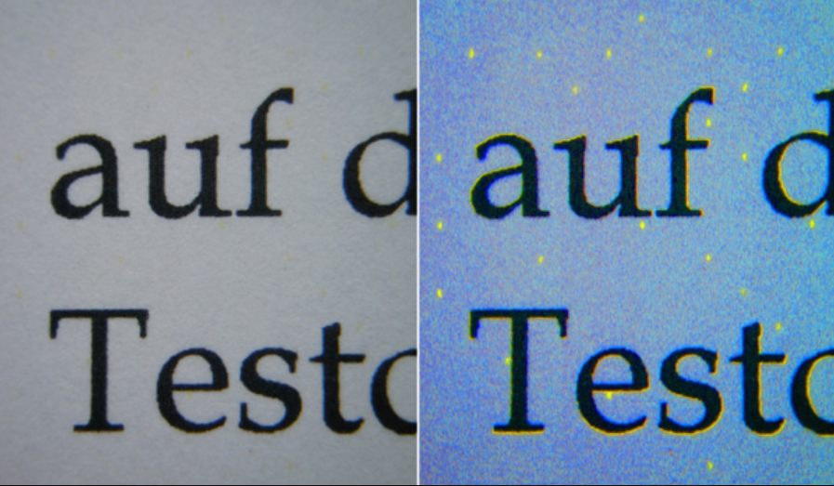
Why do we still use it?
You can delete this slide when you’re done editing the presentation
Information authenticity | watermarking & fingerprinting protect ownership and trace leaks
Device / data tracking | printers, cameras, and digital documents embed invisible IDs
Covert communication | avoids detection where encryption is blocked or suspicious
Privacy & censorship resistance | helps individuals communicate safely under surveillance
Notes:
UV light used to make the dots clearly visible

Slide 9

Use in industry
Digital watermarking: protects copyrights in photos, music, and film
Printer tracking dots: tiny yellow patterns encode printer serial + timestamp
Camera metadata: embeds device ID & shooting info for authenticity
Barcodes / QR codes: structured visual data that can carry hidden info
Document control: trace leaks or verify document origin

Slide 10
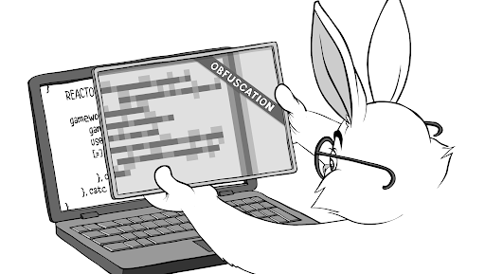
A picture is worth a thousand words

Slide 11
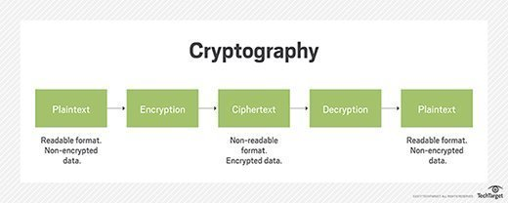
Cryptography

Slide 12
Digital Watermarking

Slide 13
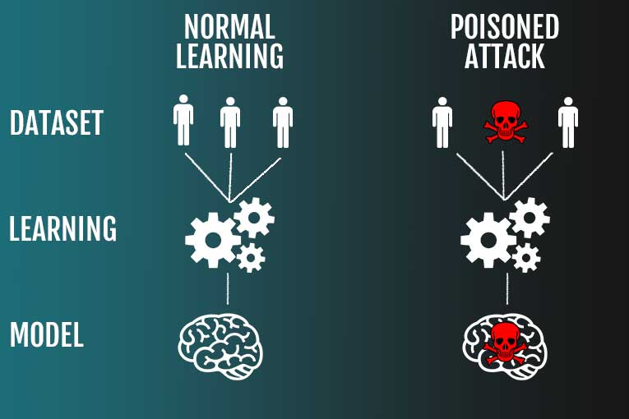
Data Poisoning

